Slide 1
Beer Manufacturing in Australia
December 2025
AU Industry Report

Slide 2
IBISWorld | Beer Manufacturing in Australia
Dec 2025
Definition
"Raising the bar: Continued falls in beer consumption are challenging revenue as the major brewers rely on acquisitions to stay in control"
Industry operators manufacture beer, ale, stout or porter. Operators generally package beer in kegs, bottles or cans, and sell it to bars, wholesalers and retailers. The industry does not include production of non-alcoholic beer.
Industry Report

Slide 3
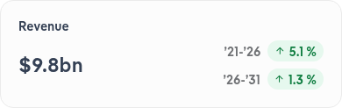
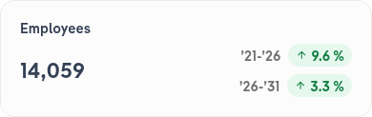
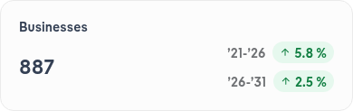

IBISWorld | Beer Manufacturing in Australia
Dec 2025
Performance Highlights
Consumers' growing preference for higher-priced beers has boosted industry revenue despite demand falling. While overall beer consumption has fallen, higher priced beers have increased revenue as consumers spend more per beer for perceived quality and unique experiences.
Industry Report
Notes:
Rising costs have slashed profit margins for beer manufacturers. Climbing excise taxes, increased costs for key inputs like coarse grains and rising competition due to increased industry participation have led to expenses outpacing selling prices, squeezing profit margins.
Asahi and Lion's market dominance through acquisitions makes it challenging for smaller breweries to compete. Controlling around half of the market, their scale and resources overshadow small independent brewers struggling with rising costs and limited market reach.
Declining per capita beer consumption is threatening manufacturers' performance. Health consciousness and rising beer prices are causing Australians to drink less beer, forcing breweries to innovate and adapt to maintain revenue and attract customers.

Slide 4
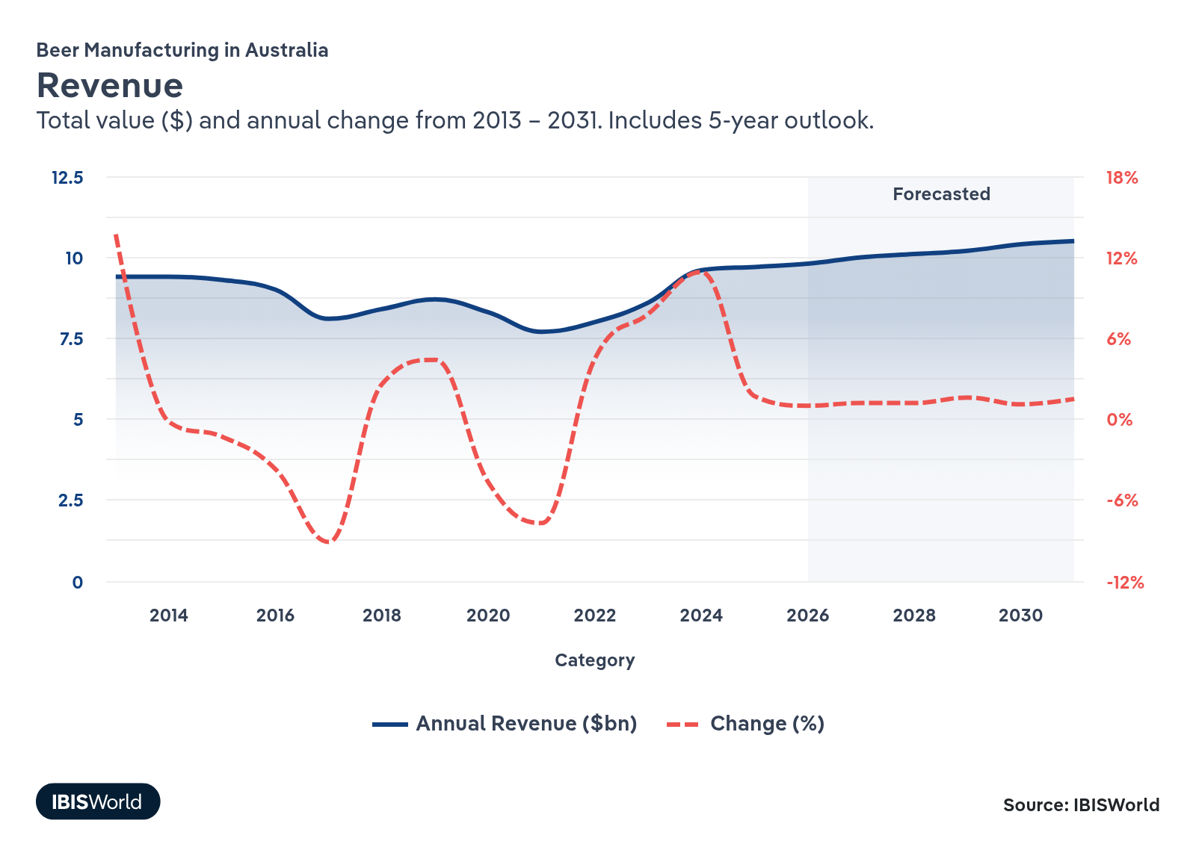
IBISWorld | Beer Manufacturing in Australia
Dec 2025
Industry Revenue
Consumers’ growing preference for higher-priced beers has boosted industry revenue despite declining consumption. Consumers are shifting away from traditional full-strength beers like Victoria Bitter and XXXX Gold and towards higher priced craft beers, elevating selling prices and increasing revenue. As per capita beer consumption falls to historic lows, drinkers are spending more per beer, favouring premium-priced craft beers for their perceived quality.
Industry Report

Slide 5
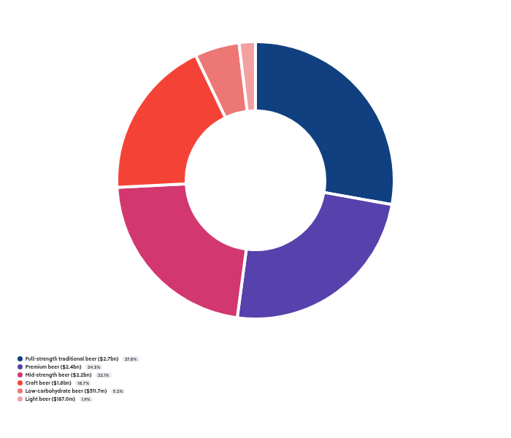
IBISWorld | Beer Manufacturing in Australia
Dec 2025
Products and Services
The new 10% U.S. tariff on Australian beer will raise exporters' costs and likely reduce their competitiveness in the US market. Brewers may seek alternative markets as a result. However, the US is not a significant export market for the industry.
Industry Report
Notes:
Craft beer sales are outpacing other segments. Consumers are increasingly favouring craft beers for their perceived quality and trendiness, boosting craft beer's revenue share over the past five years.
Mid-strength beer is gaining popularity as people drink less alcohol. With declining per capita alcohol consumption, consumers are shifting from full-strength to mid-strength beers, doubling this segment's share of total beer sold since 2000.
Light beer's appeal is declining as consumers opt for non-alcoholic options. Light beers' revenue share has nearly halved over the past five years as consumers favour zero-alcohol beers, which are not part of the industry, over light beers.
Liquor retailers are increasingly bypassing wholesalers to purchase directly from manufacturers. Major retailers like Coles and Woolworths are also developing private-label beer brands, reducing reliance on wholesalers and challenging their market position.

Slide 6
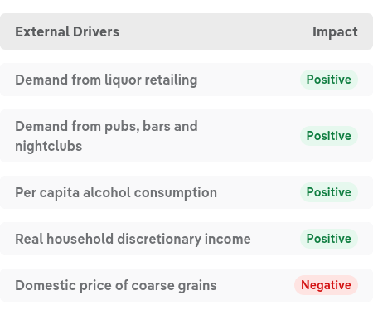
IBISWorld | Beer Manufacturing in Australia
Dec 2025
Key External Drivers
Per capita alcohol consumption has declined in recent years, primarily because of a rapid decrease in per capita beer consumption driven by health-conscious consumers. This decline threatens demand and adversely affects beer manufacturers' performance.
Industry Report

Slide 7
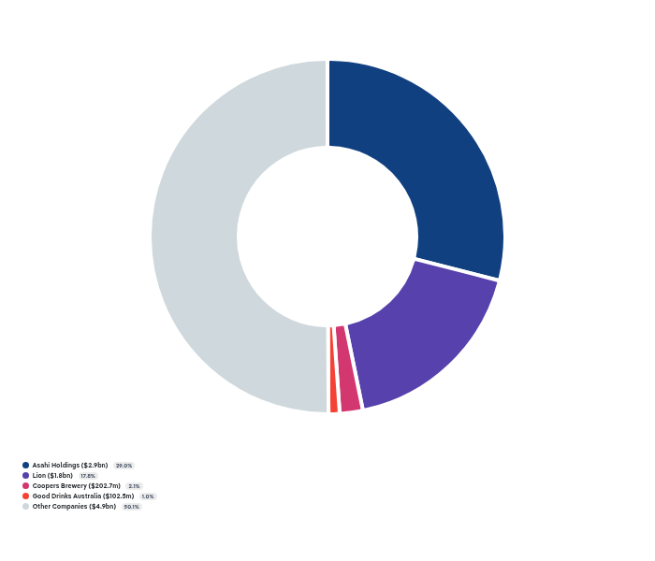
IBISWorld | Beer Manufacturing in Australia
Dec 2025
Companies
Lion and Asahi continue to dominate the market. These Japanese companies make up around half of the market, having recently acquired smaller breweries. Their scale and power make it hard for independent breweries to compete.
Industry Report
Notes:
Companies: Asahi Holdings, Lion, Coopers Brewery, Good Drinks Australia, Coca-Cola Europacific Partners Holdings (Australia)
Barring the heavyweights, the Beer Manufacturing industry is fragmented. However, craft beer’s increasing popularity has encouraged new players to enter the industry.
Companies: Asahi Holdings, Lion, Coopers Brewery, Good Drinks Australia, Coca-Cola Europacific Partners Holdings (Australia)
Asahi is focused on premiumisation and its craft brands to offset declining sales volumes with higher margin products. Asahi has begun focusing more on RTDs, introducing Hard Rated in 2023.
Companies: Asahi Holdings, Lion, Coopers Brewery, Good Drinks Australia, Coca-Cola Europacific Partners Holdings (Australia)
Facing reduced consumption of classic brands like XXXX Gold, Lion acquired Fermentum Pty Ltd in 2021. The firm is the parent company of Stone & Wood, and epitomises Lion’s shift in focus towards capitalising on craft beers’ growing popularity.

Slide 8
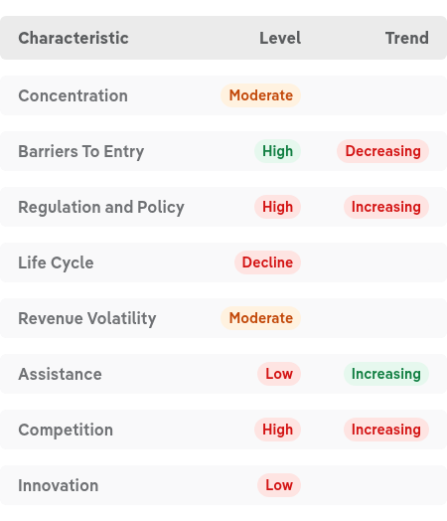
IBISWorld | Beer Manufacturing in Australia
Dec 2025
Industry Structure
Industry Report

Slide 9
Thank You
Got Questions?
Call 1-800-330-3772 or email info@IBISWorld.com
AU Industry Report

