Slide 1
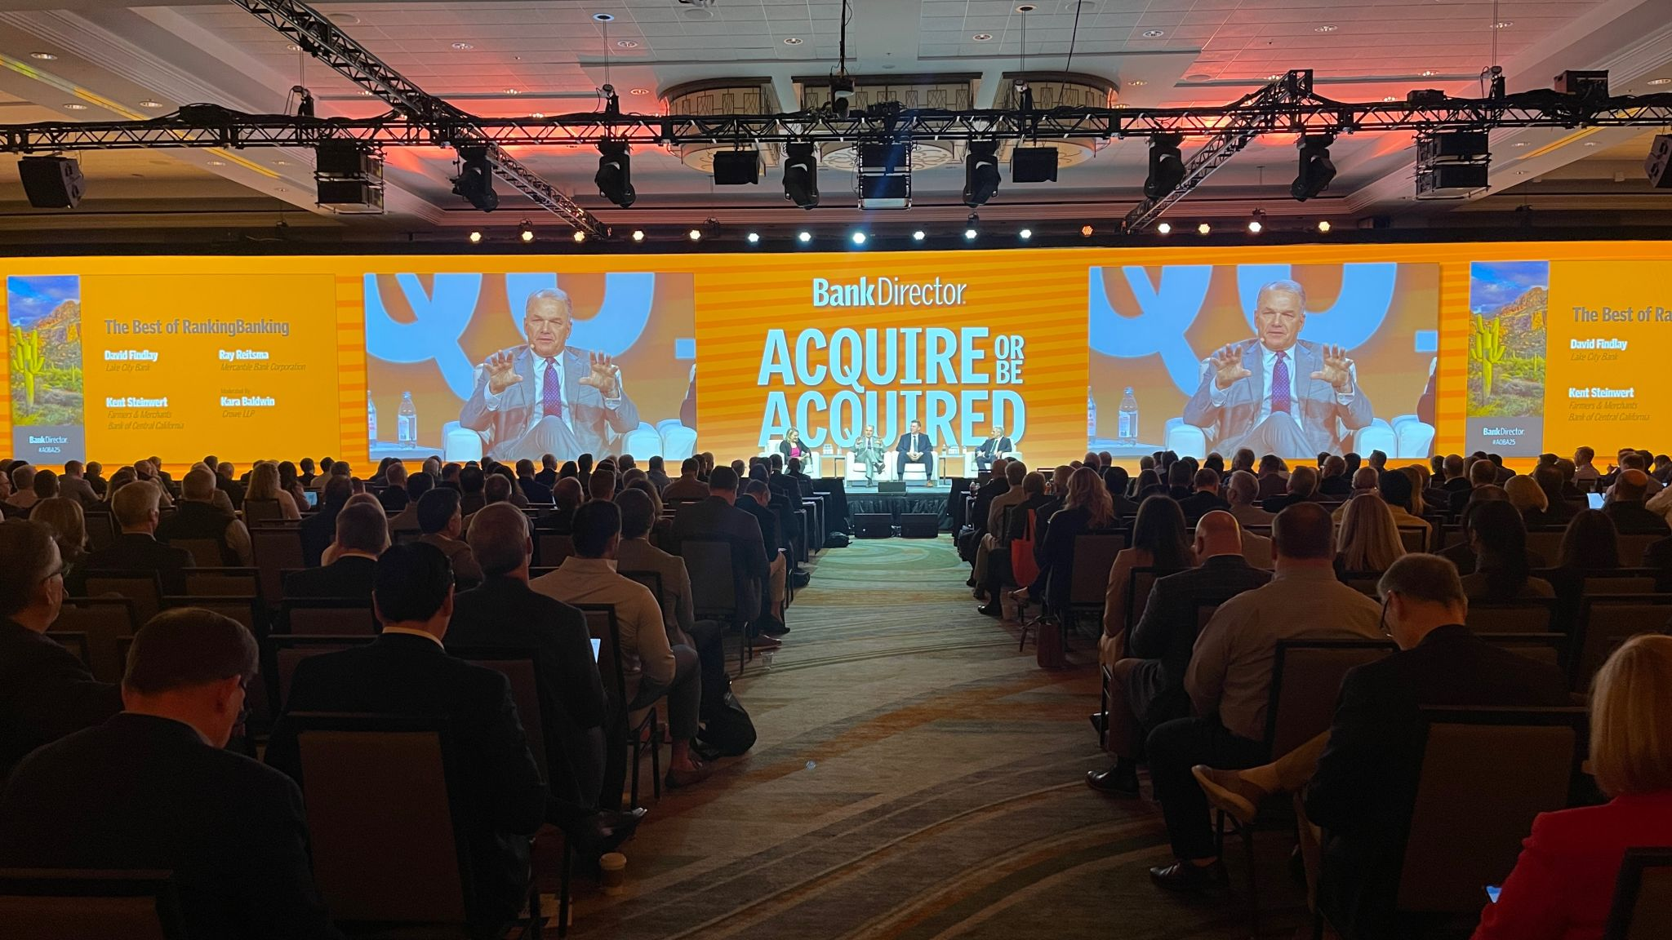
Sayonara Sonoran
Key Takeaways from Acquire Or Be Acquired
January 25th-28th, 2025

Slide 2
Our Thoughts on the Event
In an increasingly complex financial landscape, bank leaders are tasked with developing strategies that not only meet regulatory demands but also drive meaningful client engagement. With topics around AI, diversifying across asset classes, improving efficiency ratios, and a modernized approach to relationship banking, Acquire Or Be Acquired offered a forum for conversation across the banking ecosystem – C-Suite Bankers to Fintech Founders, and a range of consultative minds in between.
What quickly became clear was every attendee’s aspiration to grow; but not just growth in terms of deposits. Objectives spanned across profitability, tech stacks, business lines, and head count.
And the take-home lesson, which is now neatly packed in everyone’s luggage, is that a goal without a plan is just a wish.
As banks embark on their unique growth trajectories, it’s crucial to take pause and first determine the goal before assessing the resources at personnel. Once the goal is established, personnel’s mission will be clear, and their use of resources will be led with purpose.
Jim Fuhrman
Senior Director of Client Services for IBISWorld’s Banking Team

Slide 3
Key Trends Discussed
Prepare for Credit Cycles –
Economic downturns are inevitable; proactive risk planning ensures stability and prevents banks from entering M&A deals out of necessity.
Leverage Deposit Relationships –
Treasury relationships are 3x more profitable than deposits; cross-selling maximizes profitability across Merchant, Equipment Finance, and Credit Lines. AI as a Growth Engine –
Trusted AI models streamline credit assessments, enhance efficiency, and will soon be essential in banking, like cloud adoption.
Align for Sustainable Growth –
Breaking silos and fostering collaboration across departments enhances efficiency, client experience, and long-term profitability.
Diversify Through New Asset Classes –
Lift-out groups accelerate new product launches, helping banks quickly expand into Equipment Finance, C&I lending, and Commercial Banking.

Slide 4
Summary of Panels Attended
WSFS Unified Data for Profitability –
Jamie Hopkins showed unified data improves internal processes and transforms client experience, enhancing profitability.
Wintrust & Microsoft on AI –
Sarah Grooms and Falguni Desai emphasized AI’s role in efficiency, growth, and future banking integration.
First Financial & Wintrust Expand Offerings –
Lift-out groups are leveraged to quickly enter new asset classes, accelerating time-to-market.
White Clay on Deposits –
White Clay studies show Treasury relationships are 3x more profitable than deposits, highlighting cross-selling’s impact on balance sheets.
Teslar Software on Risk Tracking –
Joe Erdhardt stressed tracking DSCR metrics to mitigate C&I lending risks and maintain strong credit performance.

Slide 5
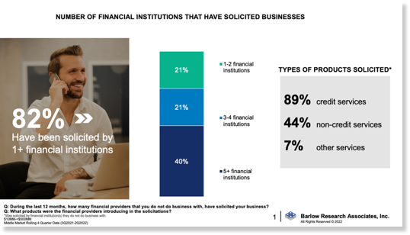
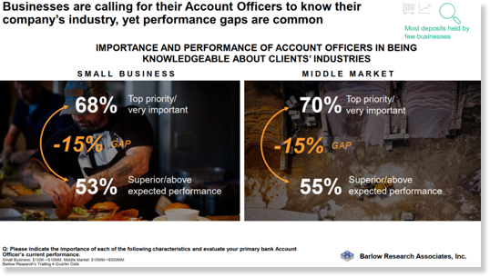
From Barlow Research…
Banking Trends to Capitalize on with IBISWorld
Thanks to our friends at Barlow Research, we know banking customers are expecting more from their bankers, but aren’t always experiencing the level of service they desire.
Banking competition is greater than ever, so it’s even more important to demonstrate experience and add value with every customer to grow customer loyalty.

Slide 6
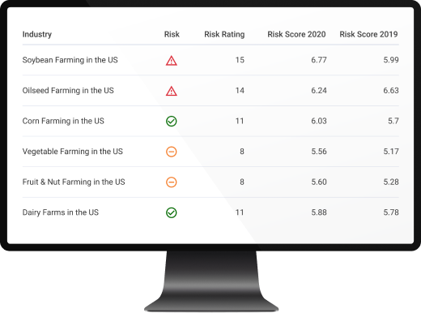
Most discussed IBISWorld topics while in Phoenix…
Welcome, Phil.
Leverage AI-driven prompts to streamline industry research, transforming complex data into actionable insights.
Utilize strategic planning tools to uncover risks, opportunities and gaps, helping you stay ahead of market trends.
Benchmark your customers’ performance against industry standards quickly and efficiently with Phil’s AI capabilities.
API : Integrating Industry Data
“Truist is using the IBISWorld API to serve up relevant industry research content to our bankers ahead of their client and prospect calls. The technical team pulls images of charts, financial figures and written summaries from IBISWorld. This information is fed into client-facing materials that the banker leverages in their client conversations. The primary benefit Truist has experienced as a result of leveraging the IBISWorld API is increased banker efficiency in call preparation. Instead of manually researching each individual industry using the IBISWorld site, bankers submit requests for this material including the industry of the client or prospect. Then, automation technology pulls the exact charts, financial figures, and written summaries using APIs for the specific industry. Formatted content is proactively delivered to the banker via email.
- Sales Enablement Leader
Understanding Your Customers
Find relevant talking points that matter to your prospects, anticipate their pain points, and tailor conversations accordingly while using their language to demonstrate expertise.
Use scripted Call Preparation Questions to help you unlock better conversations and show your knowledge of the industry.
Quickly hone in on industry pain points or opportunities to help tailor your pitch.
Spend just five minutes of prep time to elevate your understanding of the customer and sound like an expert – be a trusted advisor!
Preparing for the Next Credit Cycle
Measure, monitor and mitigate industry
risk with forward-looking trends
Using our forward-looking trends, banks use
the EWS to identify opportunities and monitor
risks across the economy at the industry level.
EWS will help you understand both the
direction and magnitude of risk changes.
Solidify your portfolio’s safety through
proactive tracking and mitigation.

