Slide 1
Soybean Farming in the US
January 2026
US Industry Report

Slide 2
IBISWorld | Soybean Farming in the US
Jan 2026
Definition
"Soy to the world: While domestic sales struggle due to decreased soybean prices, exports have faced further pressure as international competition grows"
Farms in this industry grow soybeans as their main crop. Soybeans are most often used in livestock feeds and vegetable oils, with a small but growing proportion being used in biofuel production. Establishments that sell soybean seeds to US farmers for growing crops are also included.
Industry Report

Slide 3
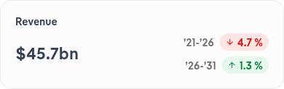
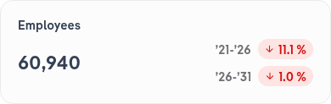


IBISWorld | Soybean Farming in the US
Jan 2026
Performance Highlights
Surging biofuel demand is giving soybean farmers new opportunities, but they're struggling with low prices and strong global stocks. Many are boosting yields to offset these challenges and stabilize income.
Industry Report
Notes:
Climate change will add volatility to yields and force farmers to reassess production practices. As the impacts of extreme seasons and weather events limit production, prices will also rise, helping revenue to continue to increase, though farmers will also face higher operating costs.
US soybean exports are under pressure as Brazil ramps up production and China cuts its imports. Farmers are diversifying markets to sustain their trade volume, emphasizing quality and sustainability to stay competitive.

Slide 4
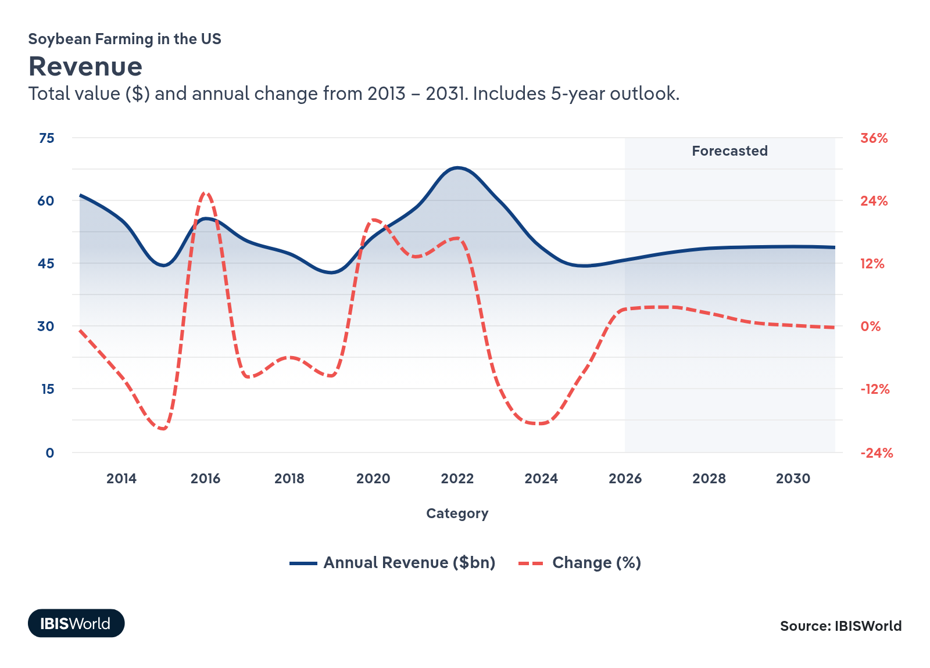
IBISWorld | Soybean Farming in the US
Jan 2026
Industry Revenue
Surging biofuel demand boosts soybean oil production and farmer opportunities. According to the USDA's December 2025 World Agricultural Supply and Demand Estimates (WASDE), a forecasted 52.3% of soybean oil production in the US will go into biofuels in the 2025/26 marketing year (MY), up from 43.7% in 2024/25 and 37.9% in 2020/21. This is largely due to supportive state and federal policies such as the Renewable Fuel Standard (RFS) program, which mandates the use of a specified level of renewable fuels, such as those produced from soybean oil.
Industry Report

Slide 5
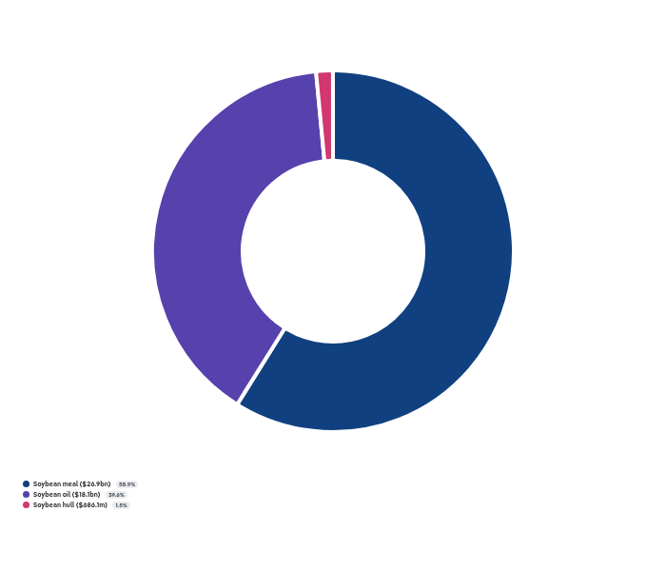
IBISWorld | Soybean Farming in the US
Jan 2026
Products and Services
Refineries need soybean oil for biodiesel. Biofuel production has grown as supply chain disruptions at home and abroad have increased gas and diesel prices.
Industry Report
Notes:
Health concerns are challenging soybeans in the edible oil market. Consumers are spending a premium on oils they see as healthier and avoiding seed oils.

Slide 6
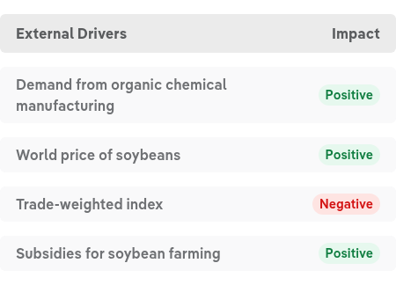
IBISWorld | Soybean Farming in the US
Jan 2026
Key External Drivers
Subsidies help protect soybean farmers when soybean prices decline. Subsidies also reduce volatility brought on by harsh growing conditions and adverse weather.
Industry Report

Slide 7

IBISWorld | Soybean Farming in the US
Jan 2026
Companies
Industry Report

Slide 8
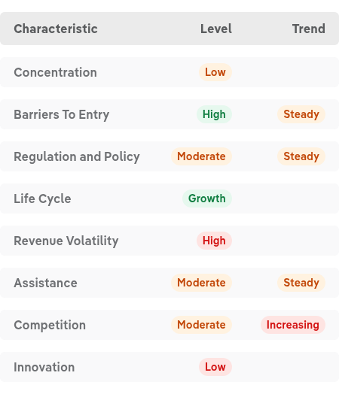
IBISWorld | Soybean Farming in the US
Jan 2026
Industry Structure
Industry Report

Slide 9
Thank You Got Questions? Call 1-800-330-3772 or email info@IBISWorld.com
US Industry Report

